Slide 1
DC Motor Design
By
A. NIVIN CLINTON
N.R. NANJAYAN

Slide 2
DC Motor design
Determination of motor Torque
Key design parameters
Motor types
DC brushed motor
DC commutation
EC brush-less motor
EC commutation
Comparison between EC and DC

Slide 3
Determination of Torque
Torque of the motor is given by
M=K*I
Where k=Torque constant
M=Torque
I=current
The Torque constant of the motor can be obtained by Speed vs Torque graphical relationship
When k=1,current value equals torque.

Slide 4
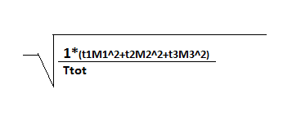
Key design parameters
RMS value of the torque has to be found
It is given by Mrms,
Where t1,t2 & t3 represents different operating time periods (both on and off time)
M1,M2 & M3 are individual torque corresponding to t1,t2 & t3 respectively.

Slide 5
Motor types
Two types
Brushed DC motor
Brush-less EC motor
Features of these motors include
Smooth motor running even at low speed
Less vibrations
Low iron core loss

Slide 6
Brushed DC motor
DC motor has permanent magnet in stator and rotating coil in the rotor.
Brushed DC motor uses brushes in commutation process.
Commutation process : Process of reversal of current
Graphite and metal type brushes are used.
During this commutation process, brush fire happens due to excess current leading to less life of motor.

Slide 7
Different types of brushes
GRAPHITE
Larger motors
High cost
Higher friction
Suitable for high and peak currents
Suitable for Start-Stop operation and reversal operation
METAL
Smaller motors
Low cost
Very low friction
Not suitable for high and peak currents
Not suitable for Start-Stop operation and reversal operation

Slide 8
Brushless motor - EC
It has rotating magnet in the rotor and a permanent coil in the stator.
Brushes are not used in this type hence having a higher life
These are designed for high speeds
Electronic commutation types are used in this motors.
Sensor commutation
Sinusoidal commutation
Sensor-less commutation

Slide 9
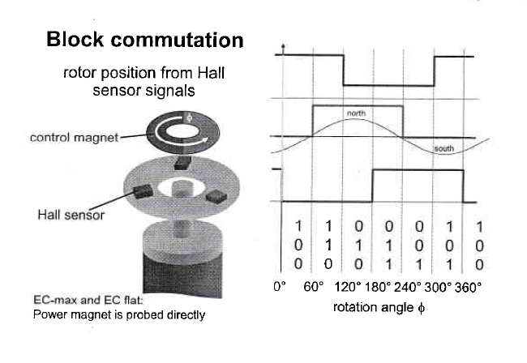
Sensor Commutation

Slide 10
Sensor less commutation
Here rotor position can be measured without sensors
The commutation control system has provision for back EMF measurement.
So when the rotor rotates, varying emf values produced will say the rotor position.
Suitable for continuous operations at high speed.

Slide 11
Sinusoidal commutation
Use of encoder to find accurate rotor position
500 pulse encoder can be used
Hall sensors are used to find starting rotor position
Recommended for smooth running even at very low speeds

Slide 12
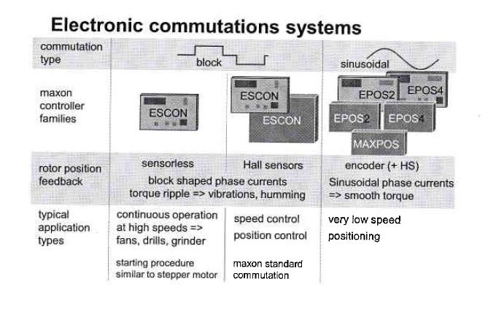
Commutation comparison

Slide 13
DC and EC comparison
Simple control and operation
Brush commutation system limits motor life
Speed limitation in these commutation
Long life
High speed
No brush fire
More expensive
Iron losses present
Sensors have to present to detect rotating magnetic field.

Slide 14
THANK YOU

